Slide 1
Establishing Goals and Savings Strategies
Presented By:
Sam Kolb, AVP – Wealth RPS Participant Education Specialist
Notes:
Welcome and Introduction
In today’s world, it’s more important than ever to prepare for your financial future. We are here to talk about various savings strategies and tying them to your financial goals.
I want to make sure you get the information you need, so please ask questions throughout our time together.
Let’s get started!

Slide 2

“
Discipline is choosing between what you want now and what you want most.
- ABRAHAM LINCOLN
Notes:
Dave Ramsey says is best…”A budget isn’t about restricting what you can spend. It gives you permission to spend without regret”
By Cruz: I like the inclusion of the quote. Provides more comfortability to the presentation and hard topic of budgeting.

Slide 3

“
Do not save what is left after spending but spend what is left after saving.
- WARREN BUFFETT
Notes:
Dave Ramsey says is best…”A budget isn’t about restricting what you can spend. It gives you permission to spend without regret”
By Cruz: I like the inclusion of the quote. Provides more comfortability to the presentation and hard topic of budgeting.

Slide 4

“
A dream written down becomes a goal. A goal broken down into steps becomes a plan. A plan backed by action becomes reality.
- UNKNOWN
Notes:
Dave Ramsey says is best…”A budget isn’t about restricting what you can spend. It gives you permission to spend without regret”
By Cruz: I like the inclusion of the quote. Provides more comfortability to the presentation and hard topic of budgeting.

Slide 5

Be SMART About Goals
Notes:
SAY:
Saving, like budgeting, goals require you to be SMART or you will be revisiting your plan often. Your goals will be unique to you and your financial situation.
Specific – be specific about your goals
Measurable – you should be able to track your goals and celebrate small as well as large accomplishments
Attainable – goals should be realistic and achievable
Relevant – savings plan should be relevant to your current lifestyle and your financial plan
Time Based – establish a timeline and do the cost research so you know how long and the costs associated with achieving your goal
Prioritize your goals based upon your needs vs wants and consider any trade-offs with your goals. What are you willing to sacrifice today for your future goals. Just remember to be SMART when developing your strategy.
Give an example of a vague goal vs. a detailed SMART goal

Slide 6
Road to Financial Freedom
4
RETIREMENT
3
LONG-TERM GOALS
2
SHORT-TERM GOALS
1
EMERGENCY SAVINGS
Notes:
SAY: (Option 1)
How many of you currently have a savings strategy in place? What would you say is the most important part of your strategy?
You may have heard of the envelope system that can be used for budgeting or saving. Some people use several different savings accounts that are labeled (please be mindful of fees). Yet others keep track by using a spreadsheet or notebook. Whatever strategy you prefer the goal is to write it down, start with:
An emergency savings of $500-1000 just for emergencies saved in cash or an easy to access account.
An emergency savings of 3 to 6 months worth of your income in the event of disability/tragedy.
People can generally separate their goals into two distinct categories:
Short term goals…write them out, set aside a dollar amount to cover that specific need within the next year to three years. Celebrate the WINS along the way.
Long term goals…college funding, buying a house, or any other large purchase that you may have over the next several years or even decades.
Retirement…the ultimate goal of being able to retire and afford to live your preferred lifestyle needs to be approached a little differently due to the specialized investing that it requires.

Slide 7
Emergency Savings
Purpose – for emergencies or unexpected life expenses
Liquid Assets
Utilize bank products and/or cash
Recommendation is to break emergency savings into two achievable goals:
Save at least $500-$1000 in easily accessible funds for emergency need
Accumulate up to 3 to 6 months worth of household expenses or your household income in easily accessible funds for unexpected loss of income or tragedy

Slide 8

Short-Term Goals
Defined as funds needed for a specific purchase or financial goal within 1 to 3 years
Example:
Automobile
Vacation
Wedding
Types of products to consider:
Bank accounts, CDs, or Roth IRA

Slide 9

Long-Term Goals
Defined as funds needed for a specific purchase or financial goal within 3 to 5+ years
Example:
Home purchase
Land purchase
Extensive vacation or second home
Types of products to consider:
Bank products, CDs, Mutual Funds, Roth IRA

Slide 10
Retirement
This looks different for everyone…you define it!
What age would you like to retire?
Determine your retirement income need based on your lifestyle
Determine your income sources
Write it down!
Prioritize the life you want in retirement and be proactive about saving today
Types of products to consider:
Your employer retirement plan, IRAs/Roth IRAs, mutual funds, stocks, bank products, CDs

Slide 11
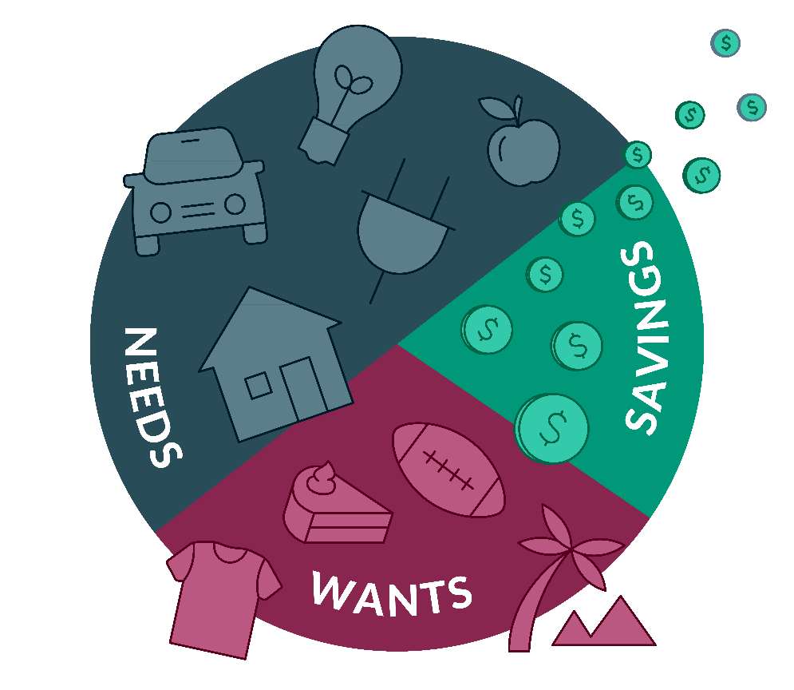

Assess Your Finances
10%-
15%
50%
20%
GOAL
30%
MAXIMIZE INCOME.
RETIREMENT SAVINGS
Notes:
SAY:
One of the easiest ways to add to your savings strategy is to simply cut expenses. Where your money is going is a humbling conversation to have with yourself.
Creating a spending plan to maximize your income will help you assess your finances.
Know how much money is coming into your household by listing all of your income sources.
Know how much money is going out by tracking your expenses
Lastly, identify how much money you can afford to save each month
Reminder, that writing out your plan and following a spending plan that fits your needs is a first step in order to achieve a savings goal of 10-15% for retirement.
Suggestions by Cruz: I thought all of the illustrations were beneficial to my knowledge from the presentation

Slide 12
Ultimate Rules of Money
Pay yourself first
Give every dollar a job… money has purpose!
Spend less than you earn
Build an emergency fund
Create a plan, get organized, & have goals
Learn how to create a passive income stream
Learn how to invest
It’s not what you make… it’s how much you spend or how much you keep!
Notes:
Suggestions by Cruz: I like this slide with actions on how to fix this. Lots of students and people my age are living paycheck to paycheck and giving a list on how to stop that can be very beneficial

Slide 13
If you want to save in a year…
Amount | Savings Plan
$1000 | $84 per month / $20 per week / $3 per day
$2000 | $167 per month / $39 per week / $6 per day
$3000 | $250 per month / $58 per week / $9 per day
$4000 | $334 per month / $78 per week / $11 per day
$5000 | $417 per month / $97 per week / $14 per day
$6000 | $500 per month / $116 per week / $17 per day
$8000 | $667 per month / $154 per week / $22 per day
$10,000 | $834 per month / $193 per week / $28 per day
Notes:
Suggestions by Cruz: I like this slide with actions on how to fix this. Lots of students and people my age are living paycheck to paycheck and giving a list on how to stop that can be very beneficial

Slide 14
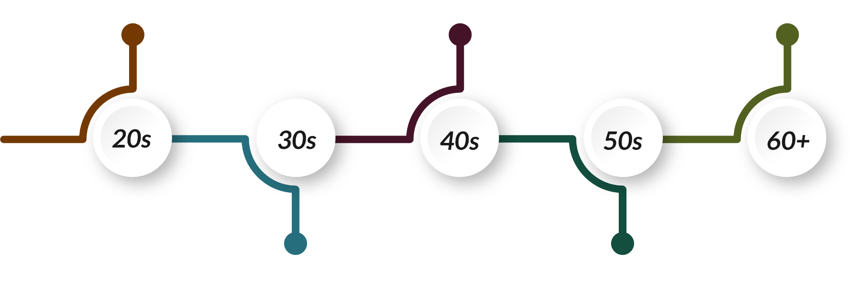
Saving Decade-by-Decade
GET STARTED
KEEP GOING
FINALIZE
LIFE CHANGES
CATCH UP
Please reference the retirement savings checklist
Notes:
SAY:
I want to spend a little time today talking with you to better understand your mindset about money. We have provided you a checklist of various items you may want to consider when you think about your money. (Go Over Checklist)
Money is a tool that is tied to a goal. Writing those goals down and setting up a strategy that works for you is the easiest way to keep track of your success. This is all hopefully a reminder for you to set aside some time to make a plan.
Let’s look at a decade-by-decade checklist to help you sort through some of your savings milestones.

Slide 15
Tax Efficient Savings Strategies
Tax NOW
Tax LATER
Tax ADVANTAGE
EASY TO ACCESS
SHORT-TERM GOALS
TAXED ON WITHDRAWAL
LONG-TERM GOALS
TAX FREE WITHDRAWAL
LONG-TERM GOALS
Please reference the savings worksheet
Notes:
SAY:
If you were to project your life on a timeline, there are a number of short- and long-term goals that you will likely
plan and save for, like a new home, college education for your children, retirement, travel or charitable giving.
How and when you plan to use the money are important factors in deciding the most tax-efficient type of investment
to help you reach your goals. Let’s look at the various types of accounts that you can use to save for your goals.
Tax NOW - Pros/Cons: Easy to Access/Little or No Interest
Tax LATER – Pros/Cons: Tax-Deferred (taxed on withdrawal)
Tax NEVER – Pros/Cons: Tax-Free Withdrawals
Suggestions by Cruz: How can I create a savings strategy? What does that look like? Who can I ask for help??

Slide 16
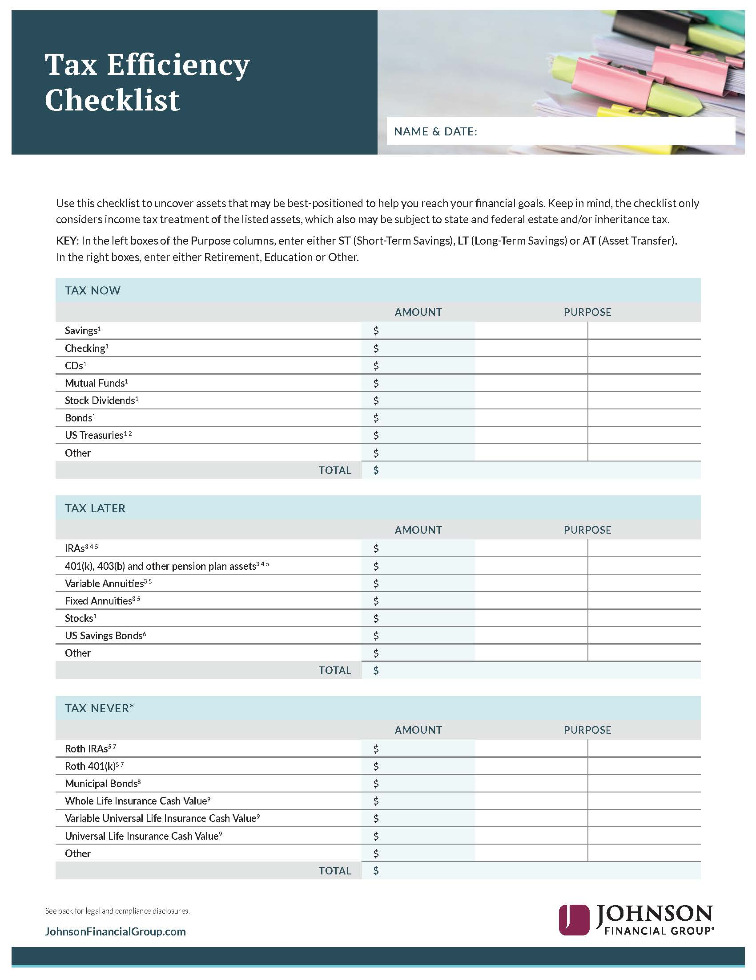
Tax Efficient Savings Strategies
1 Interest, dividends and/or capital appreciation subject to taxation when realized.
2 US Treasuries are generally exempt from state and local income tax.
3 Gains subject to income tax when withdrawn.
4 Generally funded with pre-tax dollars.
5 Distributions prior to age 59½ may incur a 10% premature distribution penalty; may incur surrender charges.
6 Generally exempt from state income tax. Special tax benefits may apply.
7 Funded with after-tax dollars; gains may be tax-free.
8 Interest is free from federal income tax; may be subject to state income tax, federal alternative minimum tax and capital gains tax.
9 The primary purpose of life insurance is the death benefit protection. Withdrawals may be available income tax-free to the extent of basis. Lifetime distributions of the cash value are subject to possible income taxation and penalties, could reduce the death benefit and cause the contract to lapse.
*The withdrawal of dividends or the amount of a loan or partial surrender may be subject to ordinary income taxes.
The material contained in this document is considered general education. These materials are not intended to constitute plan or participant specific recommendations nor advice to take or not to take any specific action. Johnson Financial Group and its representatives and employees cannot provide legal, accounting, or tax advice or services. Work with your Johnson Financial Group representative and, as appropriate, your attorney and tax professional for additional information. NOT BANK GUARANTEED | NOT FDIC INSURED | MAY LOSE VALUE

Slide 17

Purpose of Money
Overcome common obstacles:
Lifestyle inflation
Lack of personal discipline or motivation
Unexpected expenses
Inflation and market changes
Build financial resilience:
Review your financial plan
Track your progress
Make adjustments based on life changes
Prioritize by aligning goals with life values and timelines
READ:
“The Psychology of Money” by Morgan Housel
“Your New Money Mindset” by Brad Hewitt and James Moline

Slide 18

Financial Freedom Cycle
REPEAT THE PROCESS
KNOW WHERE YOU STAND
INVEST IN YOUR FUTURE
SET YOUR GOALS
AVOID LIFESTYLE INFLATION
YOU
TRACK YOUR MONEY
CREATE MORE INCOME SOURCES
SPEND LESS
SAVE SURPLUS MONEY
PAY OFF DEBT

Slide 19
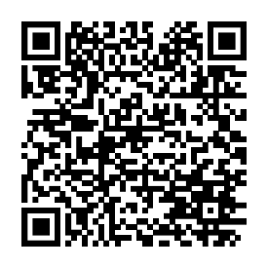

For More Information
Scan the QR Code for more resources!
Participant Account Access:
https://participant.johnsonfinancialgroup.com
Download the “Work, Save, Retire” Mobile App
RPS Participant Support Center:
RetirementServices@worksaveretire.com
Call: (888) 755-3039, Monday – Friday | 7am to 7pm
Notes:
If you need help with general enrollment questions, please reach out to our RPS Participant Service Center at 888.755.3039 or by emailing retirementservices@worksaveretire.com
Thank you for joining today’s presentation! We look forward to working with you

Slide 20
Resources
Personal Banking | Checking, Savings, HSAs, CDs | Johnson Financial Group
Access to Financial Wellness Tools
Research Financial Advisory and Banking Services
Insights Blog | Financial Insights, Industry insights, Investment insights | Johnson Financial Group
Investment Commentary (mostly weekly short-ish blog posts and articles about current economic conditions and insights into what’s driving our current economic moment)
Markets & Economy – Quarterly economic & market updates and forecasts based on current trends
Your Financial Life – (periodic) more general financial planning topics that many people encounter
[PODCAST] Your Money. Your Mission. | Johnson Financial Group
We also have a new podcast that will touch on various investment and financial topics over time
Young Professionals Registration | Johnson Financial Group
Unlock valuable knowledge and resources to learn financial independence early in your career
Connect with us on LinkedIn for more financial wellness content:
Melissa Olson | LinkedIn or Samantha Kolb | LinkedIn
National Registry of Unclaimed Retirement Assets: https://unclaimedretirementbenefits.com
Notes:
If you need help with general enrollment questions, please reach out to our RPS Participant Service Center at 888.755.3039 or by emailing retirementservices@worksaveretire.com
Thank you for joining today’s presentation! We look forward to working with you

Slide 21

SAM KOLB
Wealth Education Coordinator, Retirement Plan Services
Notes:
Closing Message Text= Font: Lato, Color: White, Size: 24 pt, Spacing: 18 pt before and 0 pt after, Line Spacing: Exactly at 22 pt

Slide 22
Disclosure
This information is for educational and illustrative purposes only and should not be used or construed as financial advice, an offer to sell, a solicitation, an offer to buy, or a recommendation for any security. The information and opinions in this report were prepared by Johnson Financial Group. Information and opinions have been obtained or derived from sources we consider reliable, but we cannot guarantee their accuracy or completeness. Opinions expressed herein are those of the author and do not necessarily represent the views of Johnson Financial Group. Opinions are as of the date of this report and are for general information purposes only. Johnson Financial Group does not warrant the accuracy or completeness of information contained herein, such information is subject to change and is not intended to influence your investment decisions. Johnson Financial Group does not undertake to advise you of any change in its opinions or the information contained in this report. Johnson Financial Group and its affiliates may issue reports or have opinions that are inconsistent with, and reach different conclusions from, this report. Johnson Financial Group does not provide legal or tax advice to clients. You should review your particular circumstances with your independent legal and tax advisors. Whether any planned tax result is realized by you depends on the specific facts of your own situation at the time your taxes are prepared. Past performance is no guarantee of future results. All performance data, while deemed obtained from reliable sources, are not guaranteed for accuracy. Not for use as a primary basis of investment decisions. Not to be construed to meet the needs of any particular investor. Asset allocation and diversification do not assure or guarantee better performance and cannot eliminate the risk of investment losses. Certain investments, like real estate, equity investments and fixed income securities, carry a certain degree of risk and may not be suitable for all investors. An investor could lose all or a substantial amount of his or her investment.
NOT FDIC INSURED * NO BANK GUARANTEE * MAY LOSE VALUE

