Slide 1
MyJFG Business
Managing Users

Slide 2
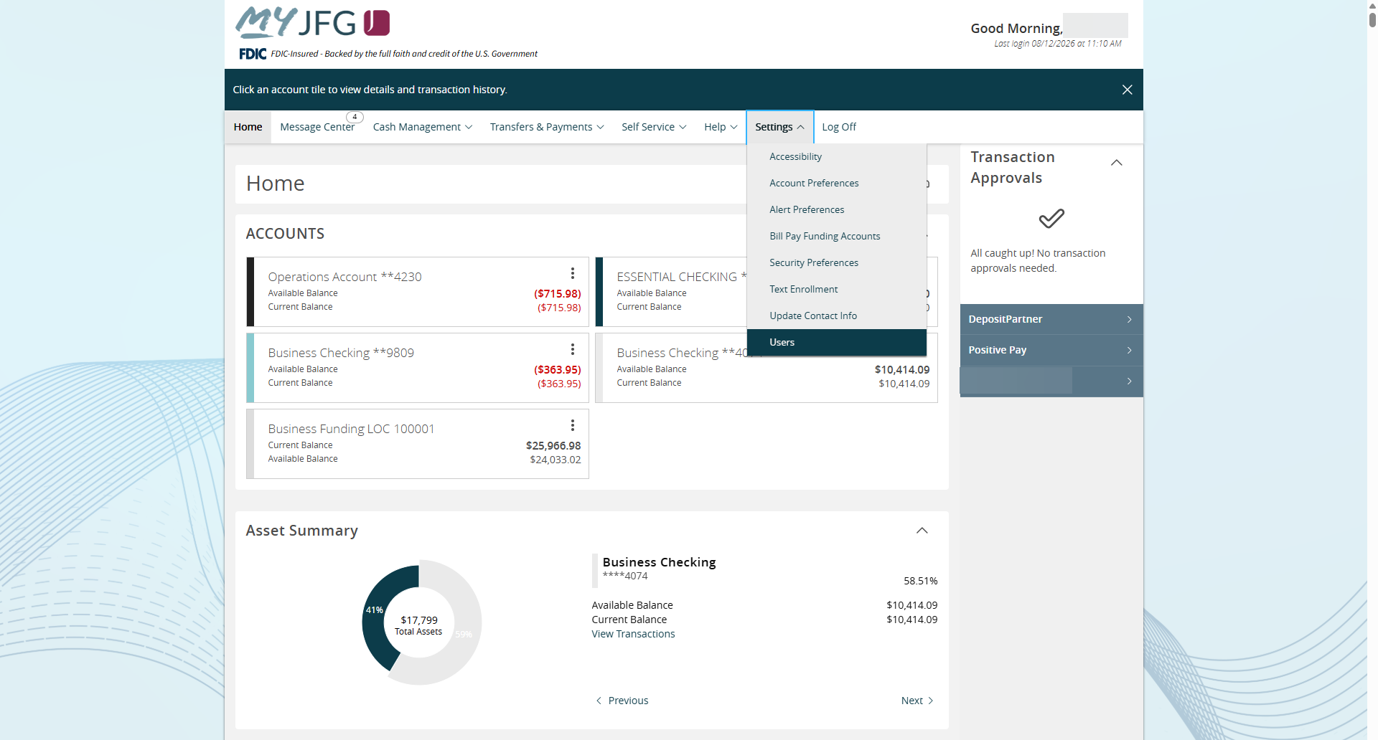
My JFG Business Add a user
Administrators can create other Users and easily assign entitlements for those Users.
To create and manage Users, click on the Settings menu and choose Users.
For additional assistance, please call 888.769.3796 (option 1, then option 2) or email myjfgbusiness@johnsonfinancialgroup.com.

Slide 3
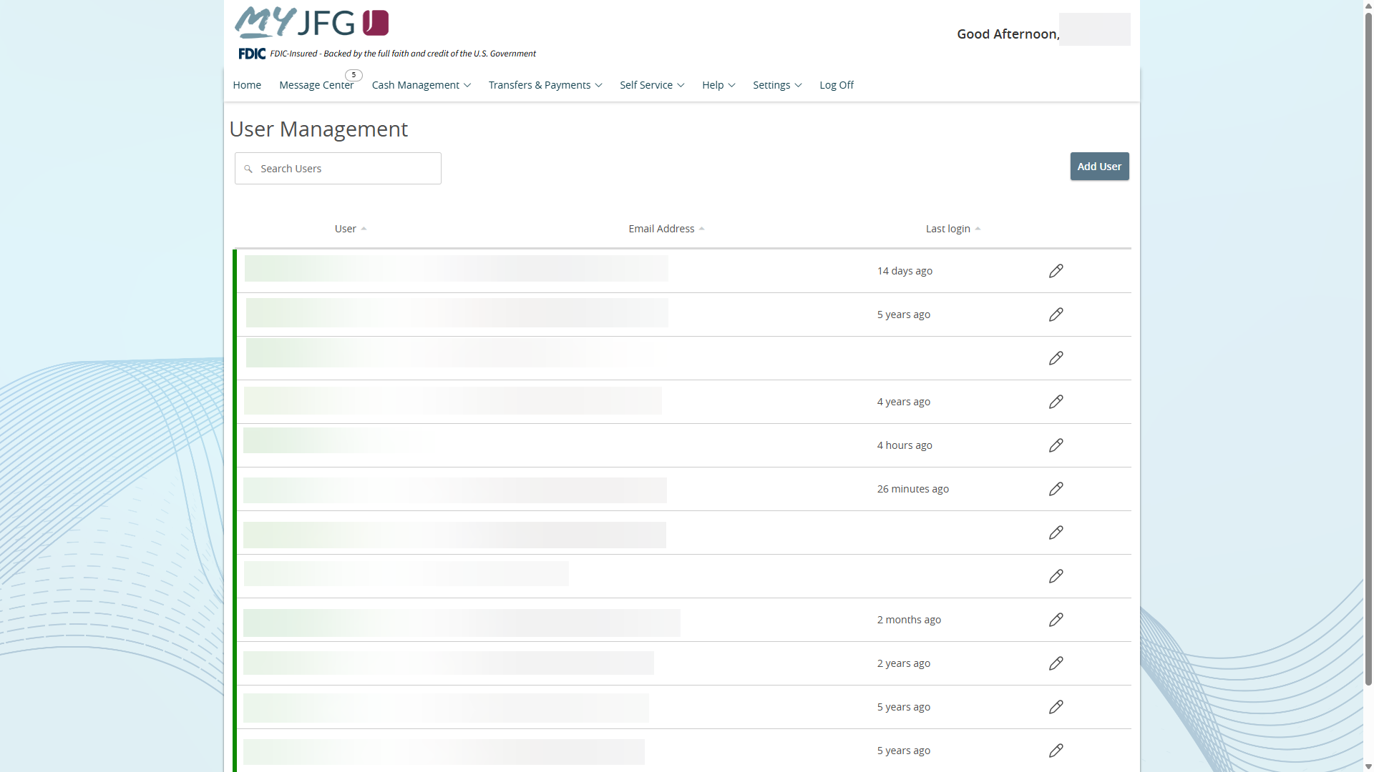
You will be taken to the User Management screen. You will see a list of any existing users for your MyJFG for Business profile.
Click Add User to create a new user.
For additional assistance, please call 888.769.3796 (option 1, then option 2) or email myjfgbusiness@johnsonfinancialgroup.com.

Slide 4
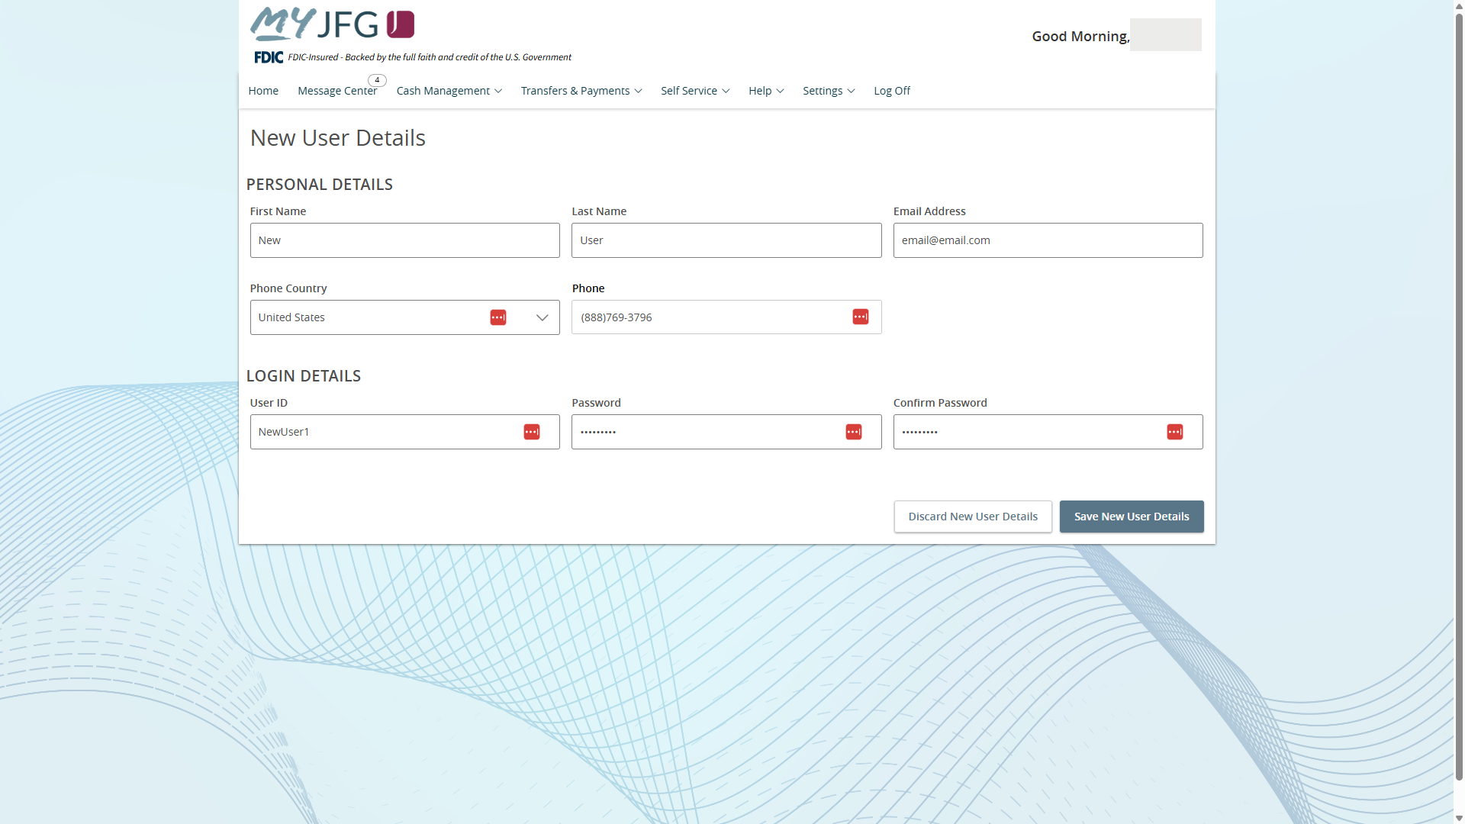
You will be taken to the New User Details screen. On this page, fill in the Personal Details of the new user. Please note, for the phone number, a direct phone number is ideal.
Next, fill in the Login Details. Create a User ID and Password for the new user. Please note, the new user will be required to update the password during the initial login.
Click Save New User Details when finished.
For additional assistance, please call 888.769.3796 (option 1, then option 2) or email myjfgbusiness@johnsonfinancialgroup.com.

Slide 5
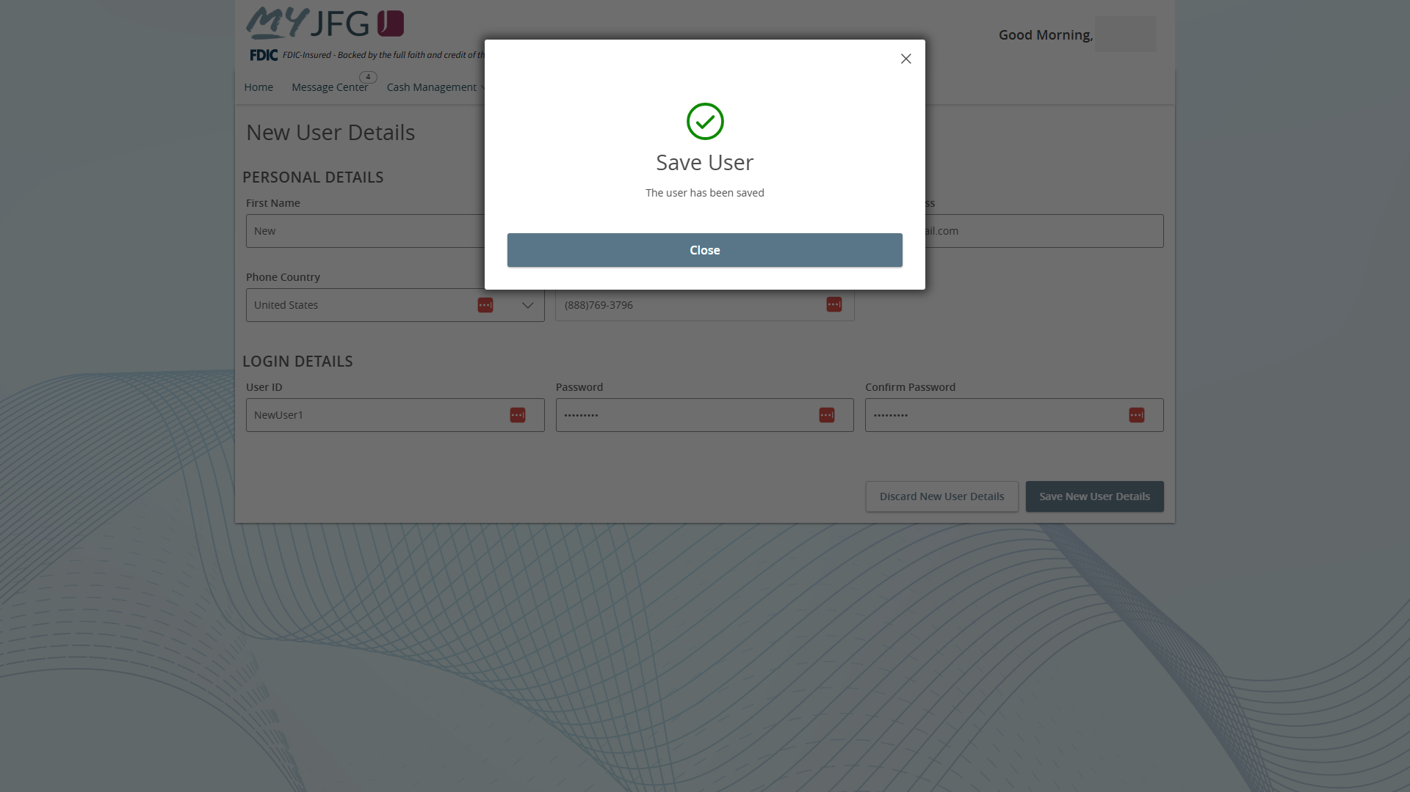
You will receive a confirmation that the new user has been saved.
Click Close to continue on to set User Entitlements for this new user.
For additional assistance, please call 888.769.3796 (option 1, then option 2) or email myjfgbusiness@johnsonfinancialgroup.com.

Slide 6
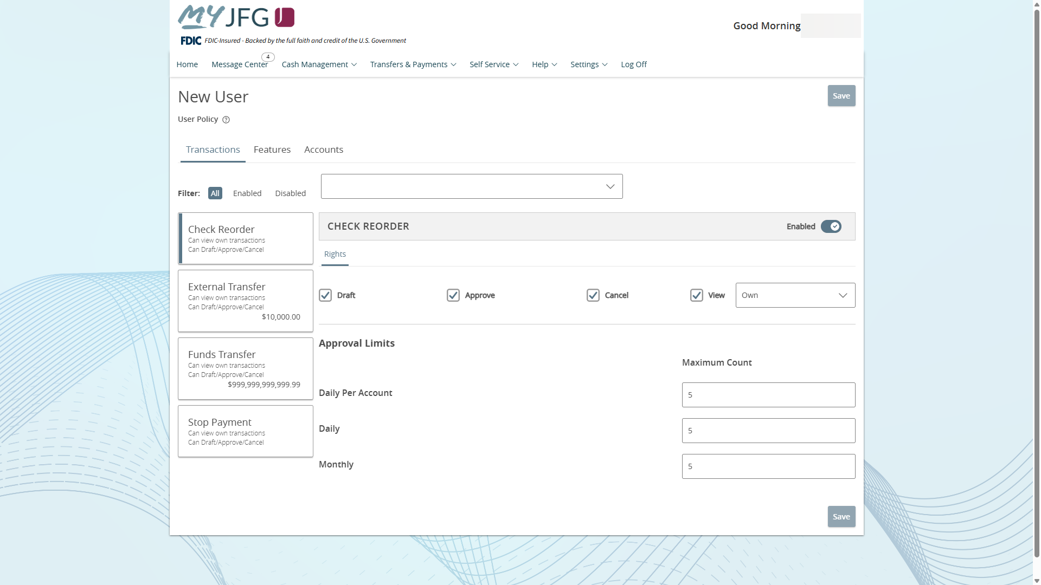
You will now be taken to the Assign Rights screen to enable user entitlements.
On the left side of the screen, you will see a list of your available transaction types. The first transaction type will be automatically selected. Select a transaction type to edit it.
For additional assistance, please call 888.769.3796 (option 1, then option 2) or email myjfgbusiness@johnsonfinancialgroup.com.

Slide 7
On the right side of the screen, you will be able to set a user’s access rights for each transaction type.
First, you will see a slider bar that you can toggle on or off to Enable or Disable the transaction for that user.
In the Rights section, you can assign Draft, Approve, and/or Cancel.
Draft allows to initiate a transaction.
Approve allows a user to approve a transaction.
Cancel allows a user to Cancel a transaction that has not processed yet.
Lastly, the View option allows a user to see transaction history for this transaction type in the Online Activity Center. The dropdown menu dictates whose transactions the user can see.
All: User can see any transaction history in this category.
Account: User can see transactions in this category only for accounts the user is entitled for.
Own: User can only see his/her own transactions.
None: User can see no transactions.
For additional assistance, please call 888.769.3796 (option 1, then option 2) or email myjfgbusiness@johnsonfinancialgroup.com.

Slide 8
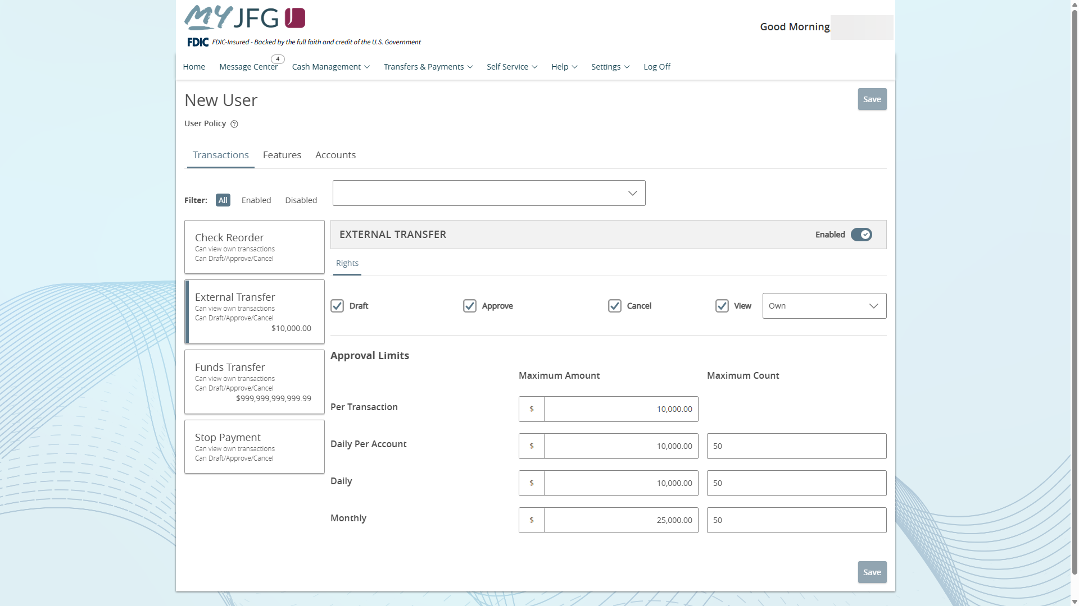
The Approval Limits section allows you to set Maximum Amount (where applicable) and Maximum Count limits for any users with Approve rights.
For additional assistance, please call 888.769.3796 (option 1, then option 2) or email myjfgbusiness@johnsonfinancialgroup.com.

Slide 9
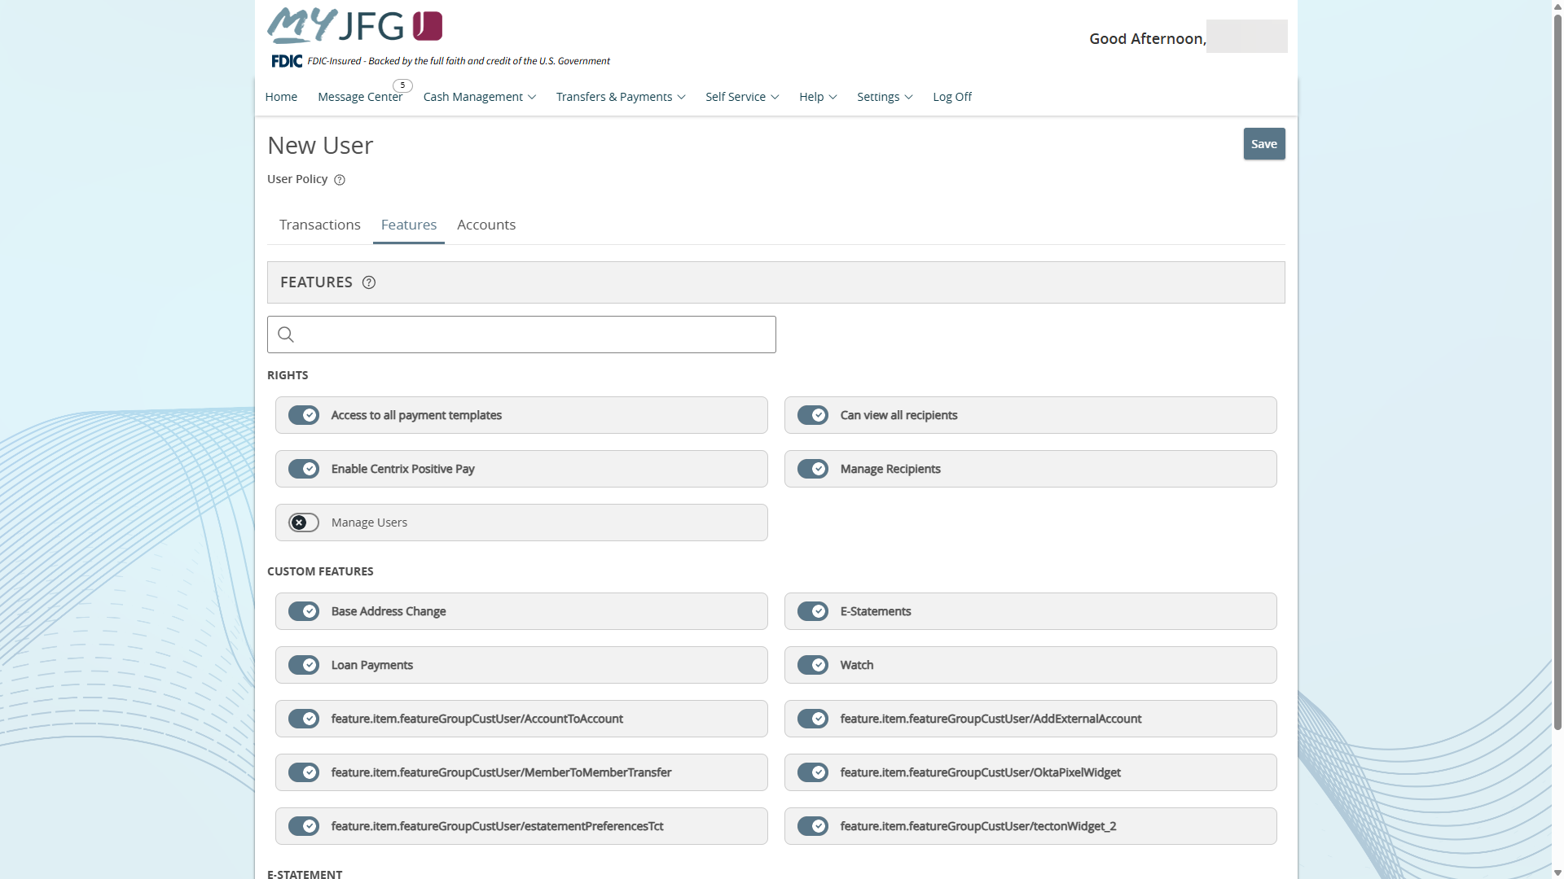
The Features tab allows you to set general online banking entitlements for this user. Turn on or off any features depending on the entitlements this user should be given.
Please note, Manage Users is an administrative function and should only be given to users who you want to be able to create or edit your online banking users.
For additional assistance, please call 888.769.3796 (option 1, then option 2) or email myjfgbusiness@johnsonfinancialgroup.com.

Slide 10
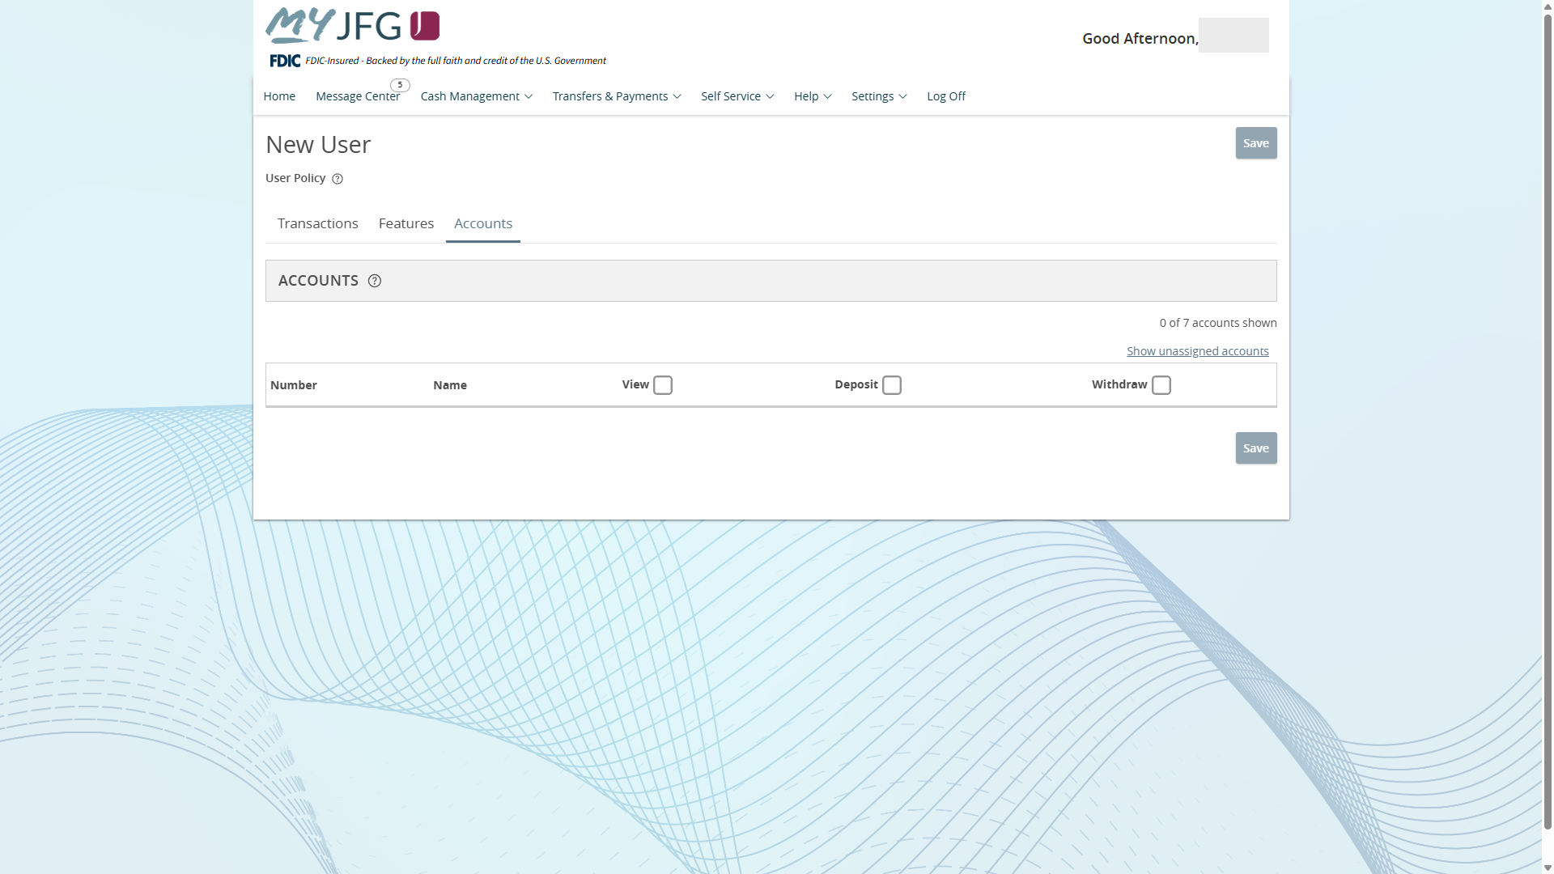
The Accounts tab allows you to assign which account(s) this user should have access to within MyJFG. To get started, click the Show unassigned accounts link
For additional assistance, please call 888.769.3796 (option 1, then option 2) or email myjfgbusiness@johnsonfinancialgroup.com.

Slide 11
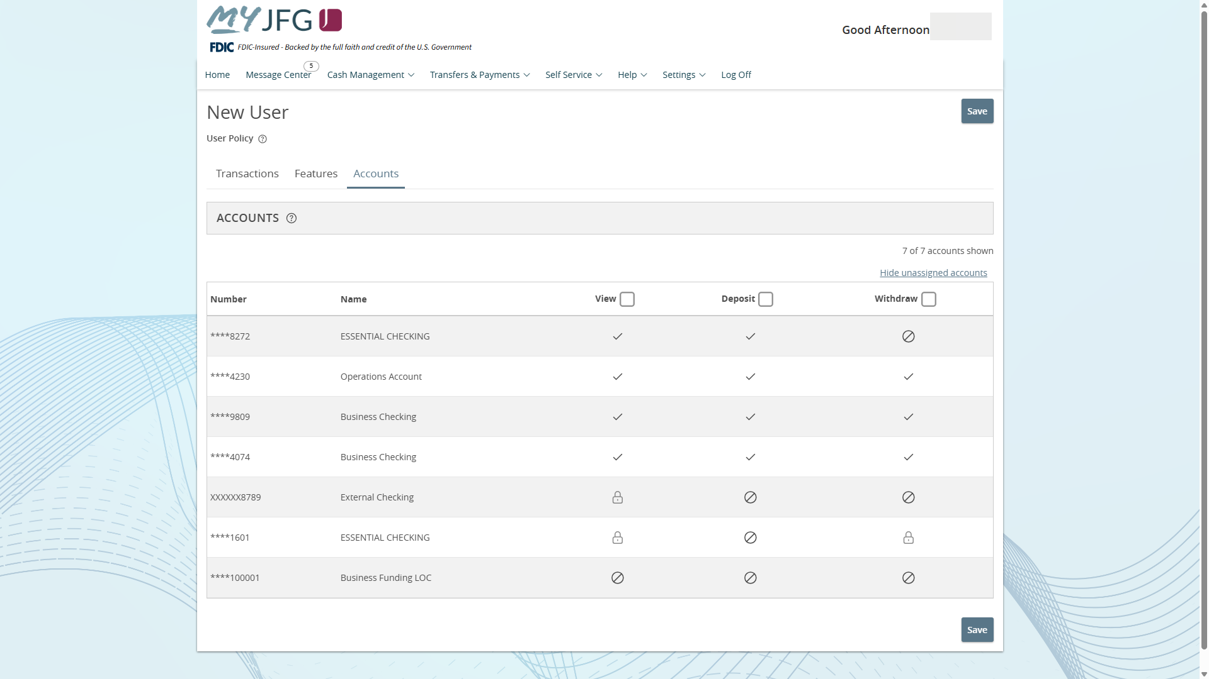
You can assign View, Deposit, or Withdraw rights to these accounts.
View allows a user to see balance and activity information on that account.
Deposit and Withdraw refers to transactions within MyJFG only. For example, a funds transfer done online would require to withdraw from one account and deposit into another account.
A padlock indicates that the option is not available for that account.
Click Save when finished.
For additional assistance, please call 888.769.3796 (option 1, then option 2) or email myjfgbusiness@johnsonfinancialgroup.com.

Slide 12

If you need to edit or delete an existing user, return to the Users screen and click the Pencil Icon for the user you wish to edit or delete.
For additional assistance, please call 888.769.3796 (option 1, then option 2) or email myjfgbusiness@johnsonfinancialgroup.com.

Slide 13
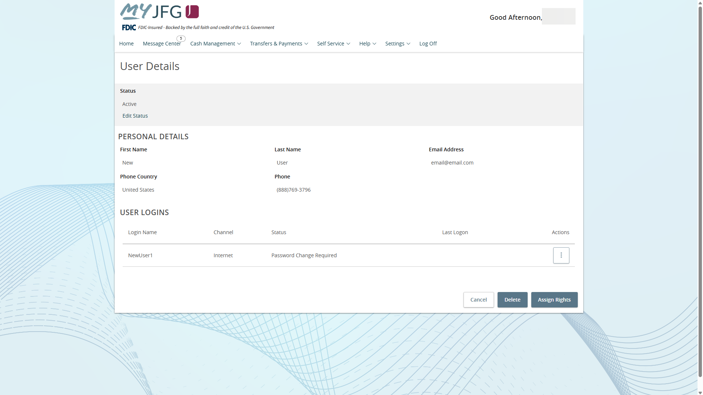
Click Edit Status to deactivate, but not delete, a user.
Click Assign Rights to edit this user’s entitlements. The process to edit rights will follow the same process as assigning rights when creating a new user.
Click Delete to permanently delete the user. You will be asked to confirm deletion if selection this option.
For additional assistance, please call 888.769.3796 (option 1, then option 2) or email myjfgbusiness@johnsonfinancialgroup.com.

Slide 14
For additional MyJFG Business guides and resources and support visit
MyJFG Resources | Frequently Asked Questions | Johnson Financial Group
To speak with us directly, contact the Johnson Customer Support Center at 888.769.3796

